Slide 1

Obesity levels in the united states
Fahad Almunif

Slide 2
Project Description
project will be about socioeconomic impact on obesity levels for a sample of people living across the United states. The ones benefitting from the study is the health industry and the citizens by considering the common factors or keys that indicate an increase in the obesity for certain individuals.
The scope of the project or the questions I hope to find an answers to from the study:
Q: How does the economy affect obesity?
Q: which states suffer from obesity the most?
Q: what is some approaches that might limit the obesity levels?

Slide 3
dataset
List of statistics of all different states thought out a range of years that indicate the obesity levels, income, location, age and many other features.
The data was obtained from Kaggle and originally the data is from the Behavioral Risk Factor Surveillance System.
Things to focus on (income, age, obesity level, number of people...etc.) with respect to location.

Slide 4
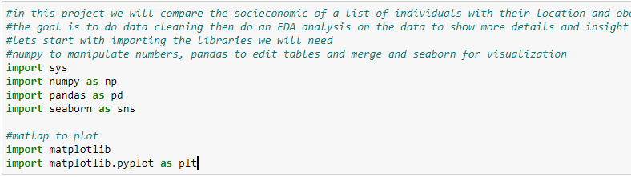
Importing

Slide 5
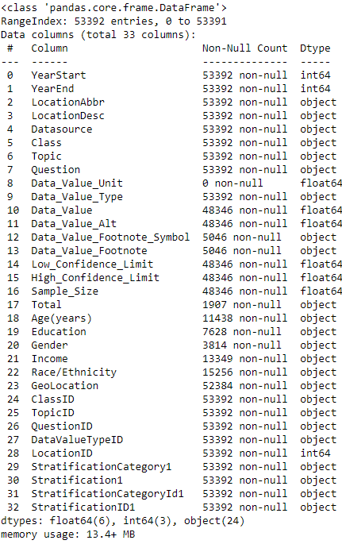
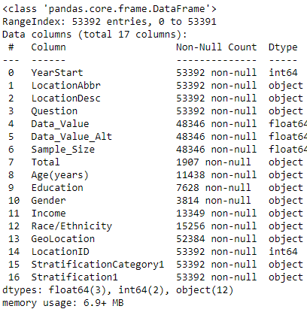

Slide 6
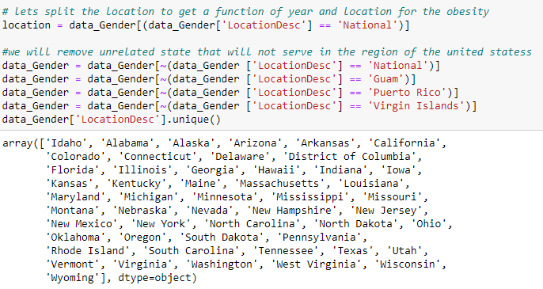
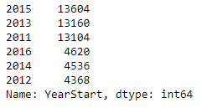
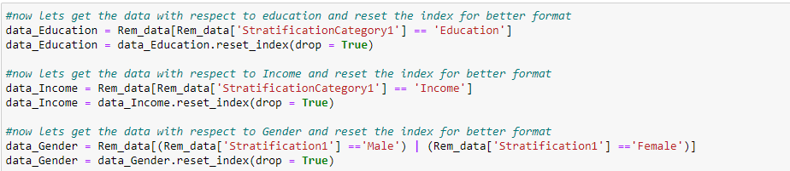

Slide 7
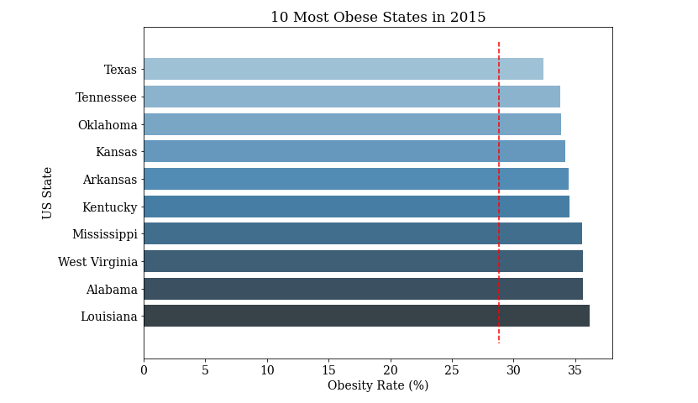

Slide 8
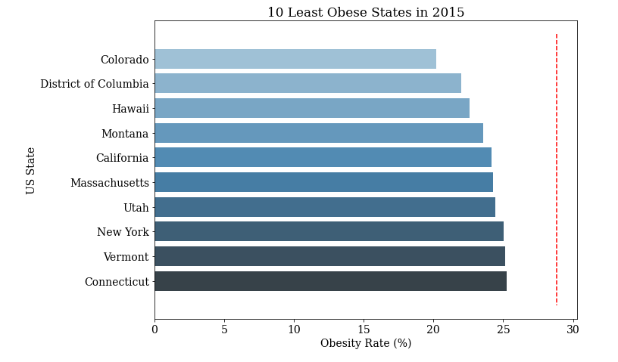

Slide 9
☺
Thank you for listening

